Slide 1
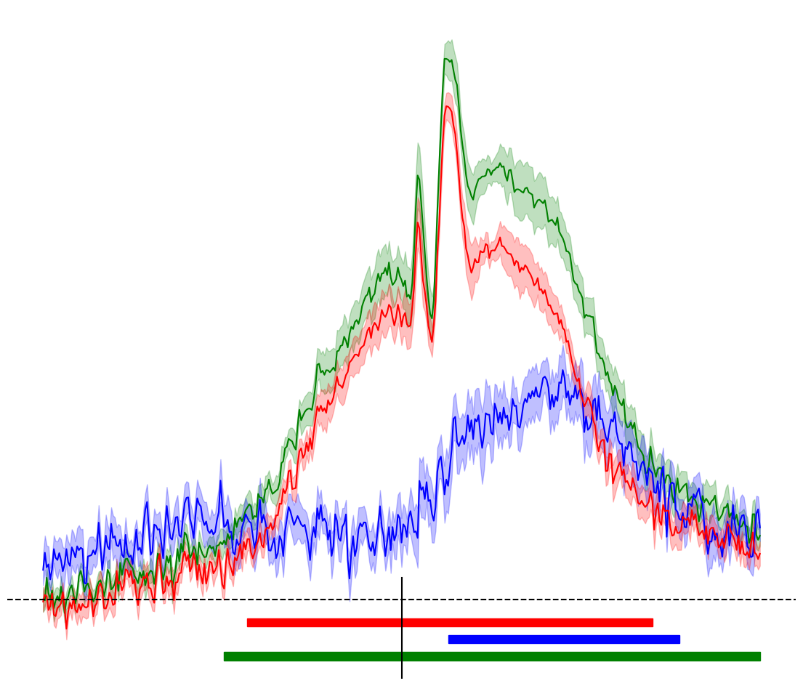
Decoding Performance over Time (AUC)
Pronoun
Noun
Proper Noun
0.65
0.575
0.50
-2s
2s
***
Word Onset
0s

Slide 2
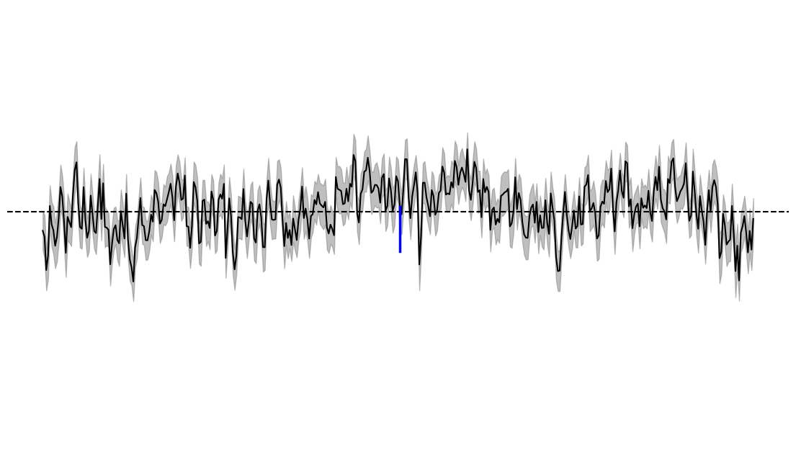
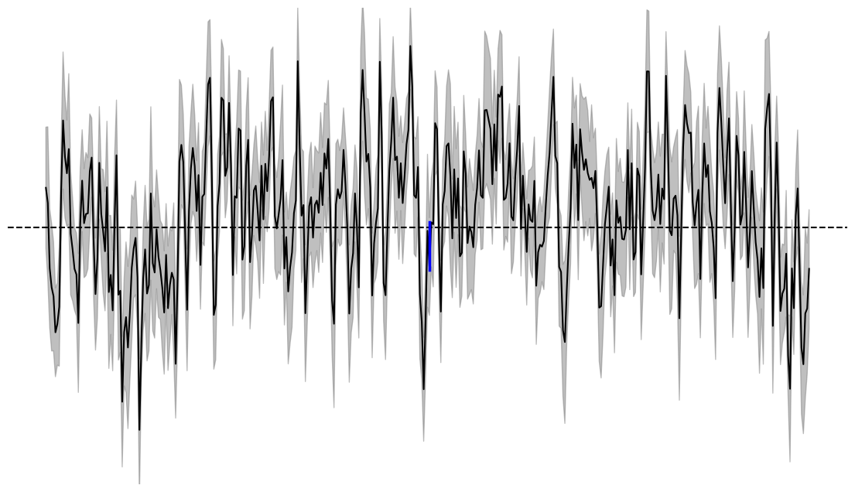
Decoding Performance over Time (AUC)
ALL
0.50
0.56
HE
0.50
0.43
Word Onset

Slide 3
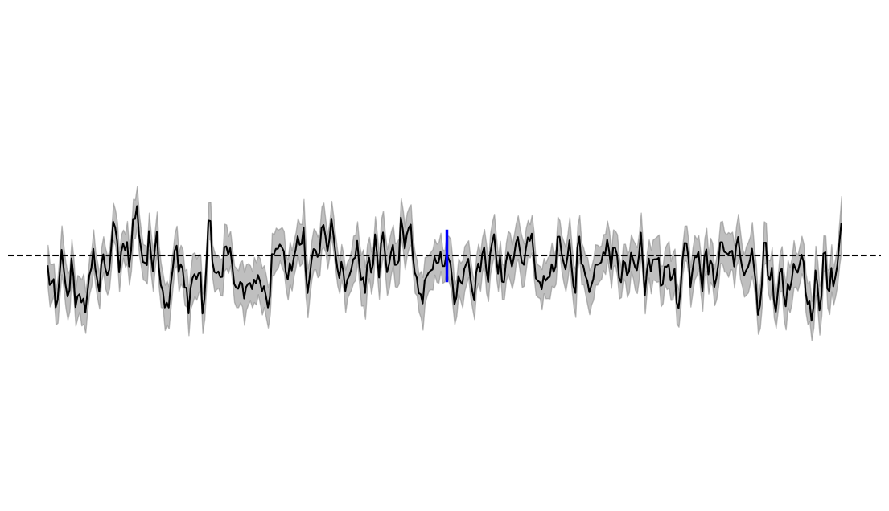
Decoding Performance over Time (AUC)
0.55
0.50
Word Onset
0.45

Slide 4
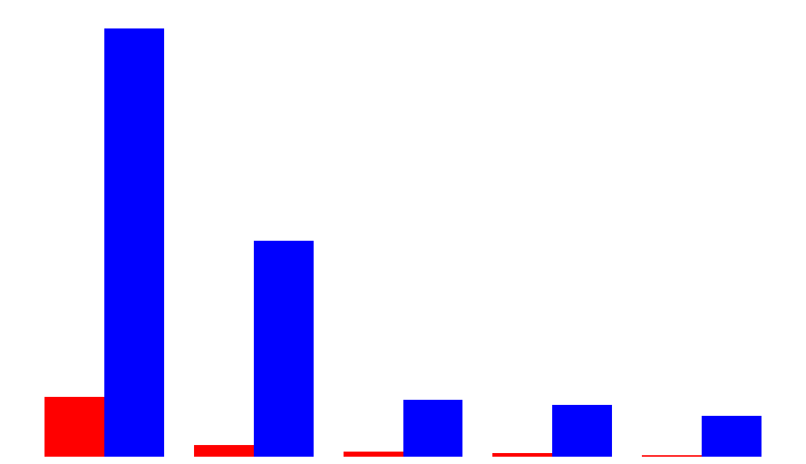
Frequency of Character References
2709
Explicit Reference
Coreference
1366
377
361
328
260
72
33
23
10
Holmes
Watson
McCarthy
Clair
Doran

Slide 5
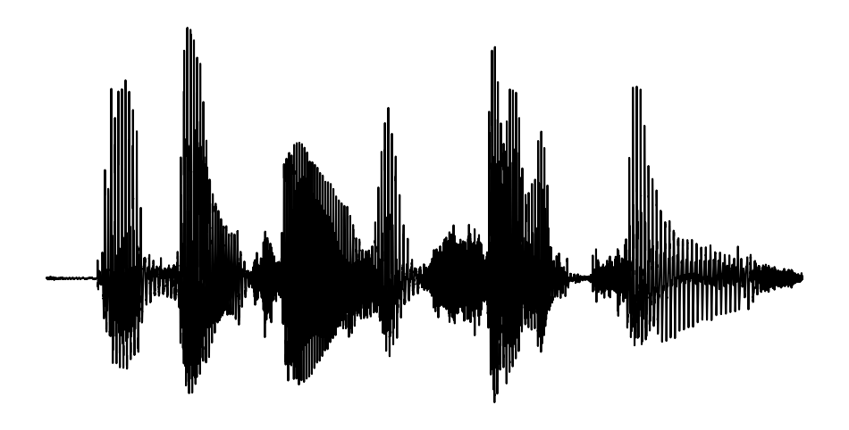

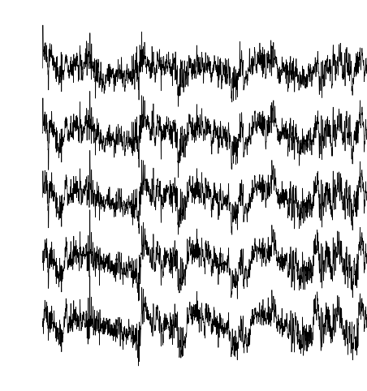

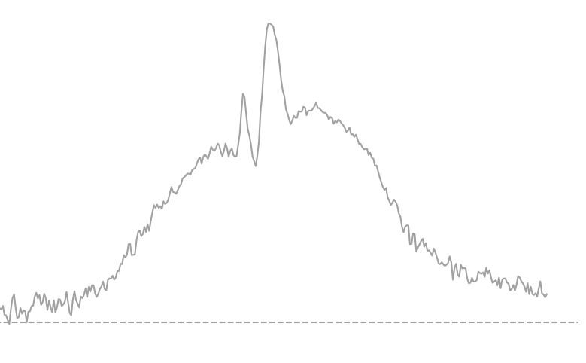
3 patients
To Sherlock Holmes she is always the women.
NOUN
PRON
PROPN
PROPN
Labels: Semantic Tags
Features: MEG Data from 269 Channels
Logistic Regression Model
ROC-AUC Plot
Class A:
56%
Class B: 44%
401 Time Points
Word Onset

